Slide 1

Machine Learning with Scikit-Learn and TensorFlow (자원탐사 융합해석을 위한 파이썬 라이브러리를 활용한 머신러닝)
KIGAM, Feb 19-23, 2018
Day 2
Daeung Yoon (윤대웅)
Hanyang University

Slide 2
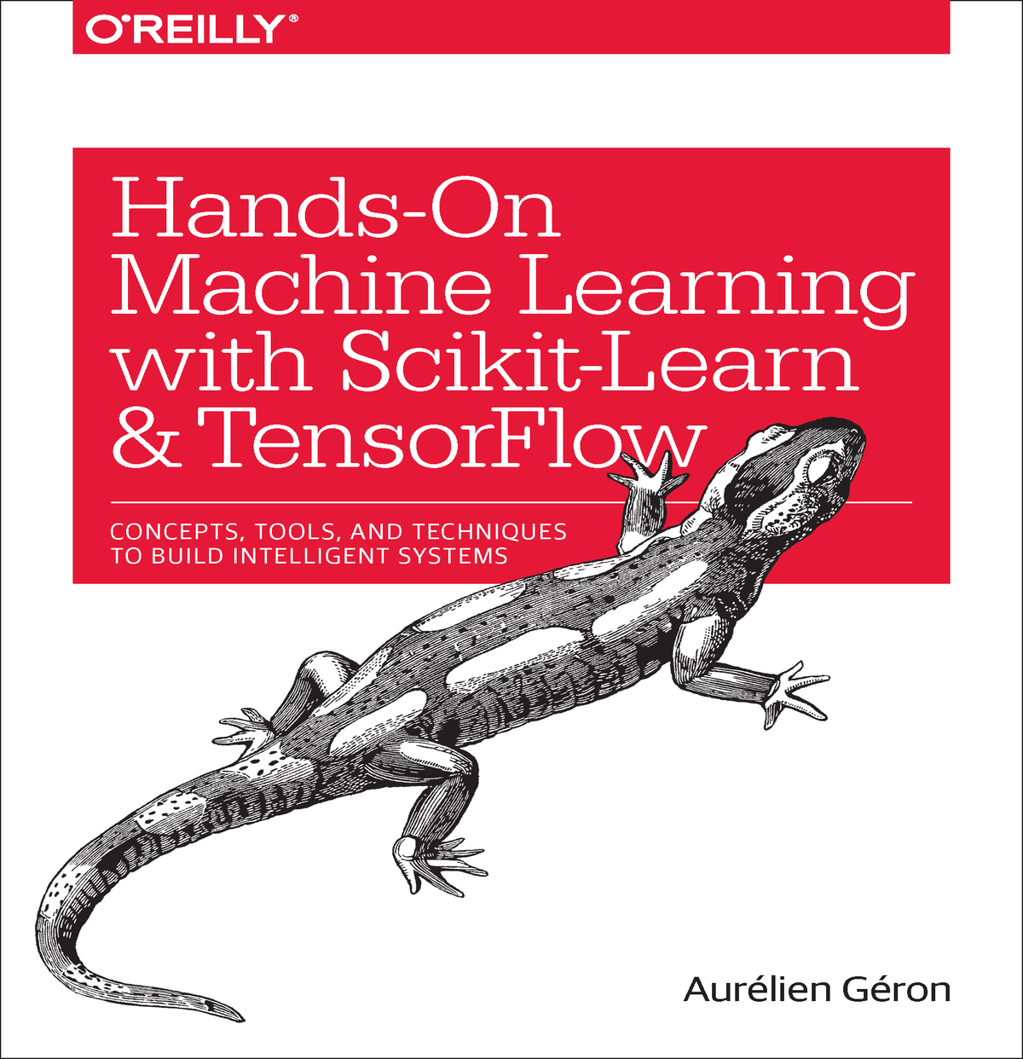
참고 자료
Hands-On Machine Learning with Scikit-Learn and TensorFlow by Aurelien Geron
Introduction to Machine Learning with Python by Andreas Muller
강의 자료 및 예제코드 다운로드 주소
https://github.com/duyoon/kigam_ml_seminar_2018

Slide 3
교육 시간표
 | 2.19 (월) | 2.20 (화) | 2.21 (수) | 2.22 (목) | 2.23 (금)
오전 | Python for machine learning | Linear/Logistic Regression | Decision Trees | TensorFlow Basics | Convolutional Neural Networks
오후 | Intro to machine learning | Support Vector Machines | Random Forests | Artificial Neural Networks | Convolutional Neural Networks
 | Data Preprocessing | Model Evaluation | Gradient Boosting | Deep Neural Networks | Recurrent Neural Networks

Slide 4
3. Linear/Logistic Regression

Slide 5
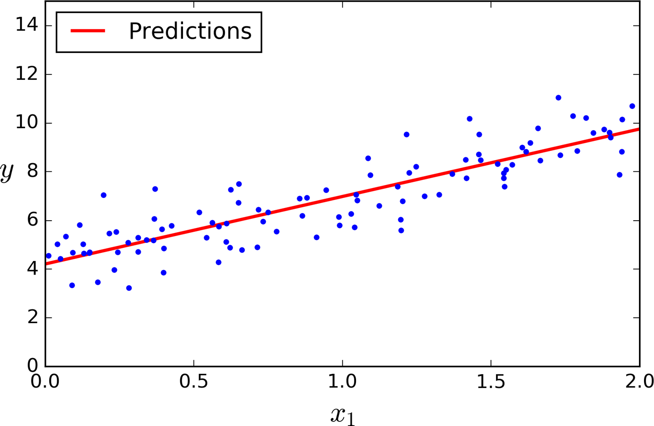
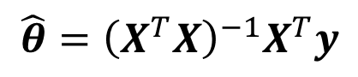
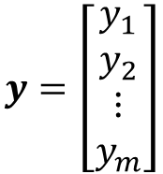
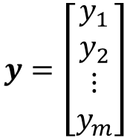
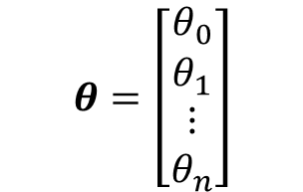
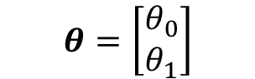

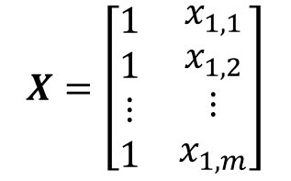
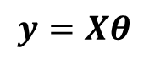

Linear Regression
For n dimensions with 1 instance:
$y=θ_{0}+θ_{1}x_{1}+θ_{2}x_{2}$+…+$θ_{n}x_{n}$
For n dimensions with m instances:
$$y=Xθ$$
$$X=\left[\begin{matrix}\begin{matrix}1 & x_{1,1}^{} \\ 1 & x_{1,2}^{}\end{matrix} & ⋯ & \begin{matrix}x_{n,1}^{} \\ x_{n,2}^{}\end{matrix} \\ ⋮ & ⋯ & ⋮ \\ \begin{matrix}1 & x_{1,m}^{}\end{matrix} & ⋯ & x_{n,m}^{}\end{matrix}\right]$$
$$y=\left[\begin{matrix}\begin{matrix}y_{1} \\ y_{2}\end{matrix} \\ \begin{matrix}⋮ \\ y_{m}\end{matrix}\end{matrix}\right]$$
$$θ=\left[\begin{matrix}\begin{matrix}θ_{0} \\ θ_{1}\end{matrix} \\ \begin{matrix}⋮ \\ θ_{n}\end{matrix}\end{matrix}\right]$$
$$y=θ_{0}+θ_{1}x_{1}$$
The Normal Equation – a closed-form solution
$$y=\left[\begin{matrix}\begin{matrix}y_{1} \\ y_{2}\end{matrix} \\ \begin{matrix}⋮ \\ y_{m}\end{matrix}\end{matrix}\right]$$
$$X=\left[\begin{matrix}\begin{matrix}1 \\ 1\end{matrix} & \begin{matrix}x_{1,1} \\ x_{1,2}\end{matrix} \\ \begin{matrix}⋮ \\ 1\end{matrix} & \begin{matrix}⋮ \\ x_{1,m}\end{matrix}\end{matrix}\right]$$
$$θ=\left[\begin{aligned}θ_{0} \\ θ_{1}\end{aligned}\right]$$
$$\hat{θ}={\left(X^{T}X\right)}^{−1}X^{T}y$$

Slide 6
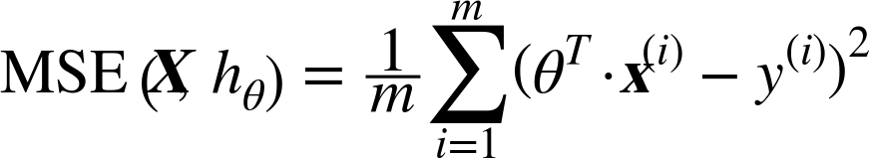
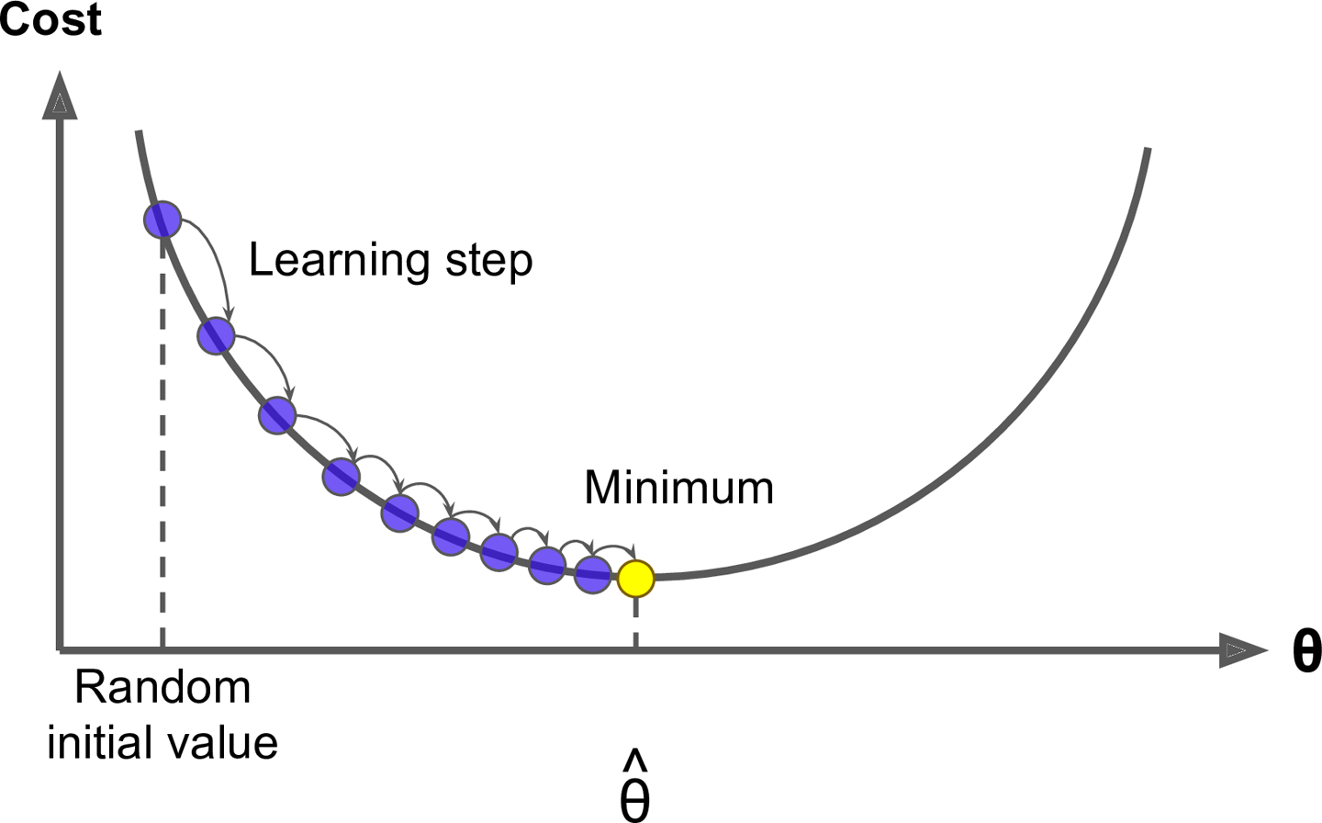
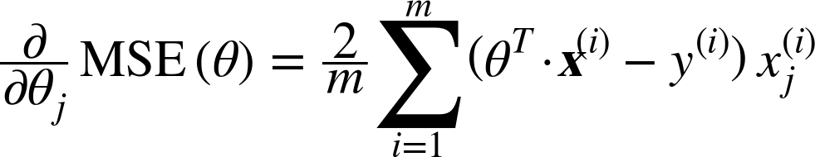
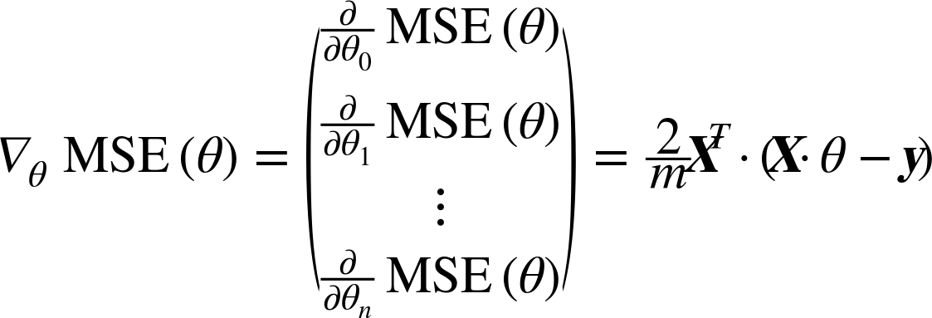
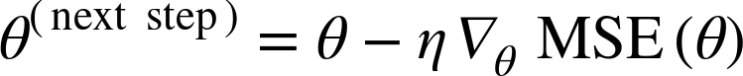
Gradient Descent
Cost:

Slide 7
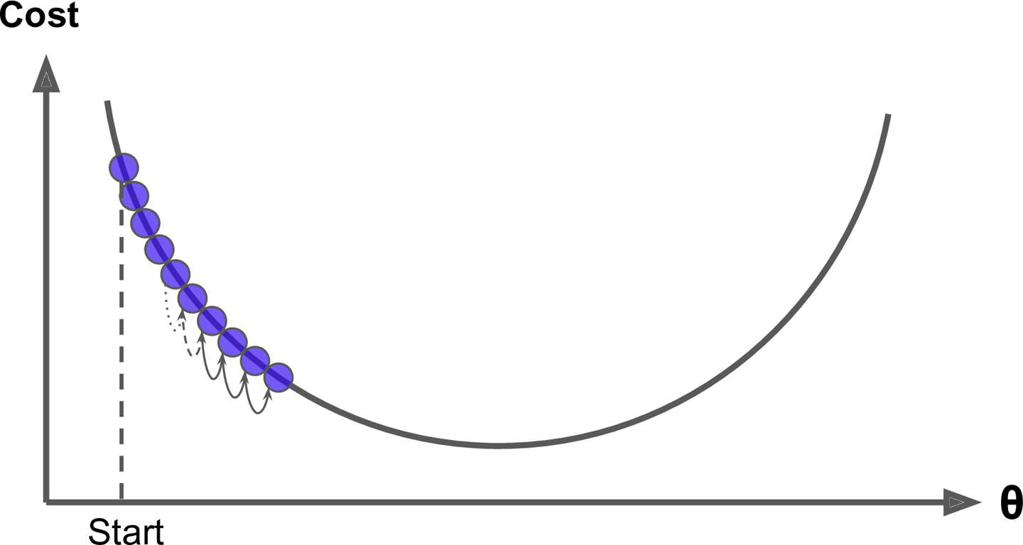
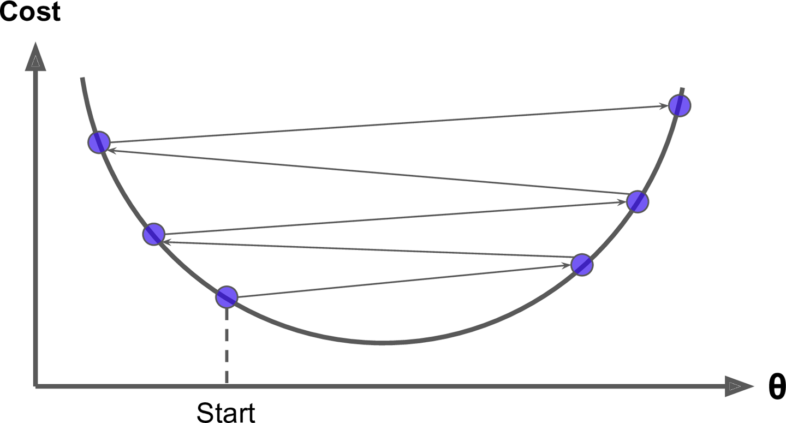
Learning Rate
Small learning rate
Large learning rate

Slide 8
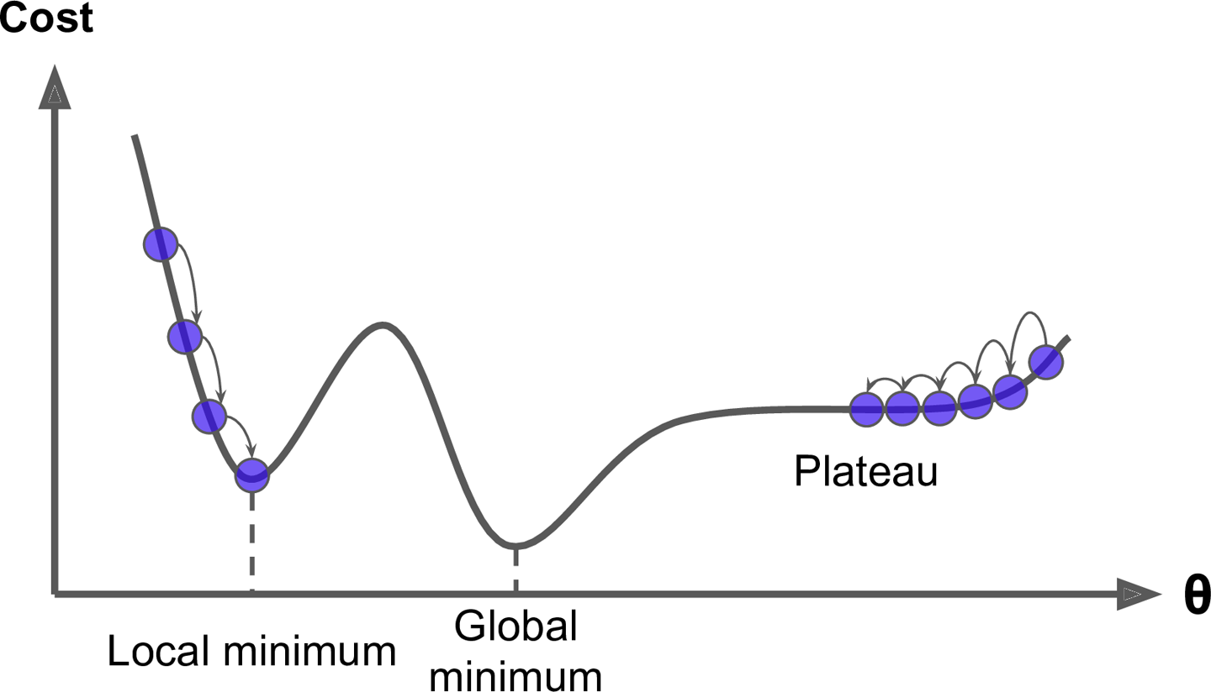
Gradient Descent

Slide 9
Types of Gradient Descent
Batch Gradient Descent
Stochastic Gradient Descent
Mini-batch Gradient Descent
A | B
A | B
A | B

Slide 10
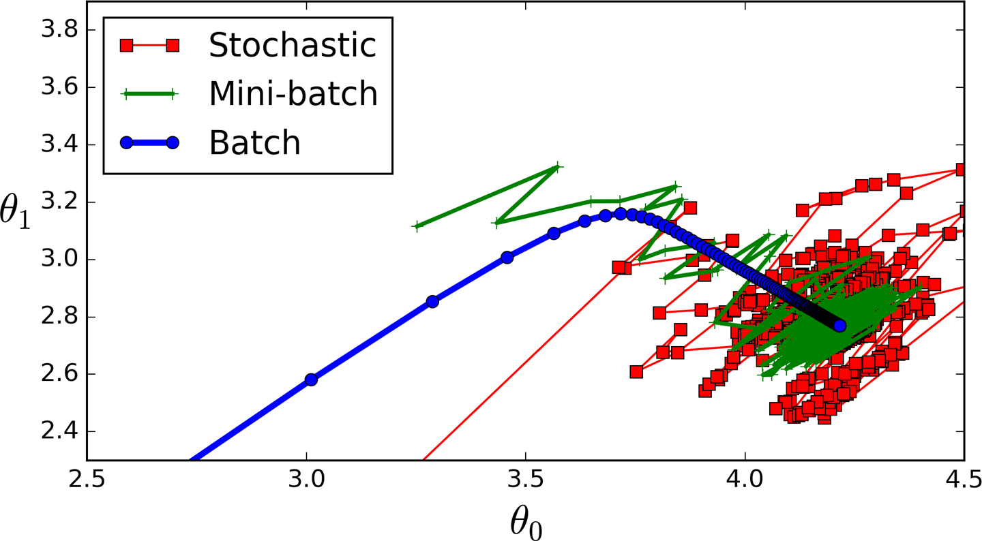
Types of Gradient Descent

Slide 11
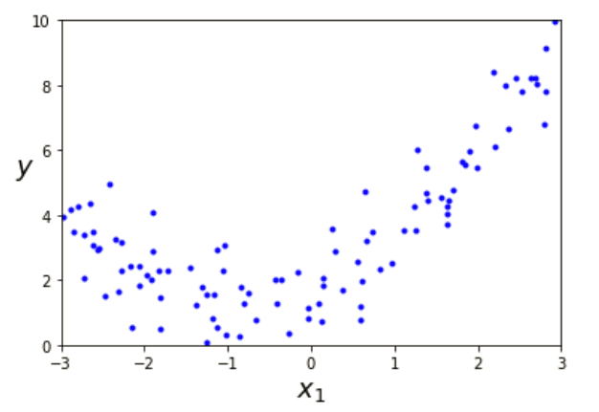
Linear Regression
For n dimensions with 1 instance:
$y=θ_{0}+θ_{1}x_{1}+θ_{2}x_{2}$+…+$θ_{n}x_{n}$
For n dimensions with m instances:
$$y=Xθ$$
$$X=\left[\begin{matrix}\begin{matrix}1 & x_{1,1}^{} \\ 1 & x_{1,2}^{}\end{matrix} & ⋯ & \begin{matrix}x_{n,1}^{} \\ x_{n,2}^{}\end{matrix} \\ ⋮ & ⋯ & ⋮ \\ \begin{matrix}1 & x_{1,m}^{}\end{matrix} & ⋯ & x_{n,m}^{}\end{matrix}\right]$$
$$y=\left[\begin{matrix}\begin{matrix}y_{1} \\ y_{2}\end{matrix} \\ \begin{matrix}⋮ \\ y_{m}\end{matrix}\end{matrix}\right]$$
$$θ=\left[\begin{matrix}\begin{matrix}θ_{0} \\ θ_{1}\end{matrix} \\ \begin{matrix}⋮ \\ θ_{n}\end{matrix}\end{matrix}\right]$$
The Normal Equation – a closed-form solution
$$\hat{θ}={\left(X^{T}X\right)}^{−1}X^{T}y$$

Slide 12
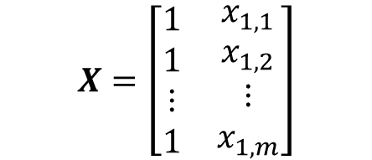
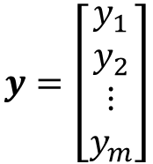
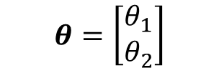

Linear Regression
For n dimensions with 1 instance:
$y=θ_{0}+θ_{1}x_{1}+θ_{2}x_{2}$+…+$θ_{n}x_{n}$
For n dimensions with m instances:
$$y=Xθ$$
$$X=\left[\begin{matrix}\begin{matrix}1 & x_{1,1}^{} \\ 1 & x_{1,2}^{}\end{matrix} & ⋯ & \begin{matrix}x_{n,1}^{} \\ x_{n,2}^{}\end{matrix} \\ ⋮ & ⋯ & ⋮ \\ \begin{matrix}1 & x_{1,m}^{}\end{matrix} & ⋯ & x_{n,m}^{}\end{matrix}\right]$$
$$y=\left[\begin{matrix}\begin{matrix}y_{1} \\ y_{2}\end{matrix} \\ \begin{matrix}⋮ \\ y_{m}\end{matrix}\end{matrix}\right]$$
$$θ=\left[\begin{matrix}\begin{matrix}θ_{0} \\ θ_{1}\end{matrix} \\ \begin{matrix}⋮ \\ θ_{n}\end{matrix}\end{matrix}\right]$$
$$y=θ_{0}+θ_{1}x_{1}$$
The Normal Equation – a closed-form solution
$$X=\left[\begin{matrix}\begin{matrix}1 \\ 1\end{matrix} & \begin{matrix}x_{1,1} \\ x_{1,2}\end{matrix} \\ \begin{matrix}⋮ \\ 1\end{matrix} & \begin{matrix}⋮ \\ x_{1,m}\end{matrix}\end{matrix}\right]$$
$$y=\left[\begin{matrix}\begin{matrix}y_{1} \\ y_{2}\end{matrix} \\ \begin{matrix}⋮ \\ y_{m}\end{matrix}\end{matrix}\right]$$
$$\hat{θ}={\left(X^{T}X\right)}^{−1}X^{T}y$$
$$θ=\left[\begin{aligned}θ_{1} \\ θ_{2}\end{aligned}\right]$$

Slide 13
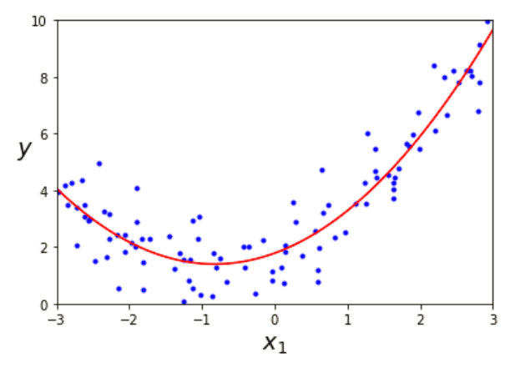
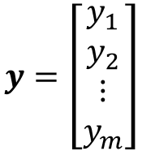
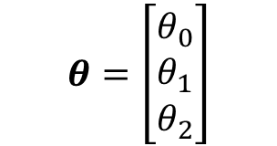
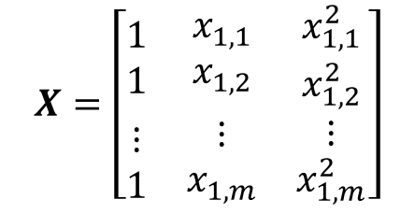
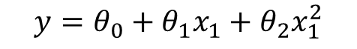
Linear Regression
Polynomial Regression
For n dimensions with 1 instance:
$y=θ_{0}+θ_{1}x_{1}+θ_{2}x_{2}$+…+$θ_{n}x_{n}$
For n dimensions with m instances:
$$y=Xθ$$
$$X=\left[\begin{matrix}\begin{matrix}1 & x_{1,1}^{} \\ 1 & x_{1,2}^{}\end{matrix} & ⋯ & \begin{matrix}x_{n,1}^{} \\ x_{n,2}^{}\end{matrix} \\ ⋮ & ⋯ & ⋮ \\ \begin{matrix}1 & x_{1,m}^{}\end{matrix} & ⋯ & x_{n,m}^{}\end{matrix}\right]$$
$$y=\left[\begin{matrix}\begin{matrix}y_{1} \\ y_{2}\end{matrix} \\ \begin{matrix}⋮ \\ y_{m}\end{matrix}\end{matrix}\right]$$
$$θ=\left[\begin{matrix}\begin{matrix}θ_{0} \\ θ_{1}\end{matrix} \\ \begin{matrix}⋮ \\ θ_{n}\end{matrix}\end{matrix}\right]$$
$$y=θ_{0}+θ_{1}x_{1}+θ_{2}x_{1}^{2}$$
The Normal Equation – a closed-form solution
$$y=\left[\begin{matrix}\begin{matrix}y_{1} \\ y_{2}\end{matrix} \\ \begin{matrix}⋮ \\ y_{m}\end{matrix}\end{matrix}\right]$$
$$X=\left[\begin{matrix}\begin{matrix}1 \\ 1\end{matrix} & \begin{matrix}x_{1,1} \\ x_{1,2}\end{matrix} & \begin{matrix}x_{1,1}^{2} \\ x_{1,2}^{2}\end{matrix} \\ \begin{matrix}⋮ \\ 1\end{matrix} & \begin{matrix}⋮ \\ x_{1,m}\end{matrix} & \begin{matrix}⋮ \\ x_{1,m}^{2}\end{matrix}\end{matrix}\right]$$
$$θ=\left[\begin{aligned}θ_{0} \\ θ_{1} \\ θ_{2}\end{aligned}\right]$$
$$\hat{θ}={\left(X^{T}X\right)}^{−1}X^{T}y$$

Slide 14
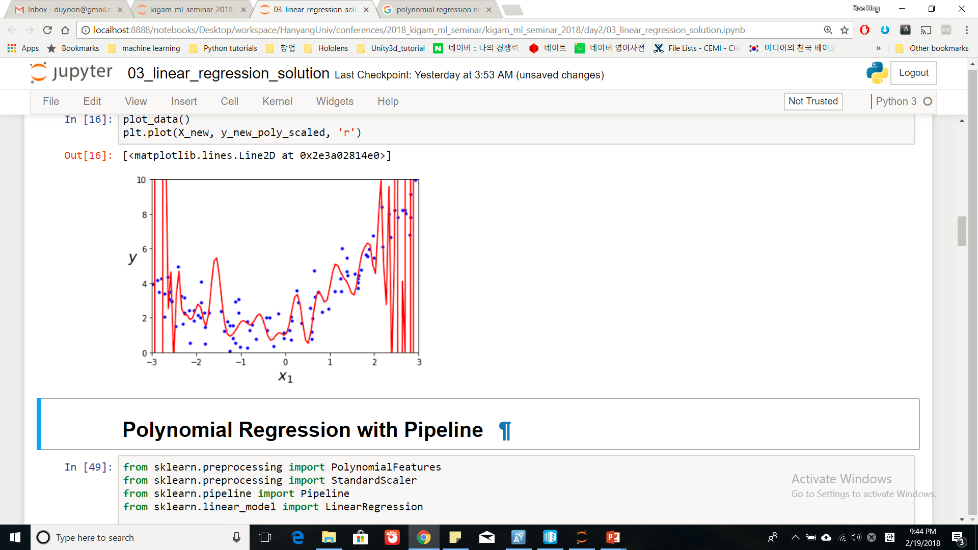
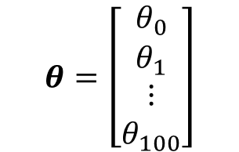
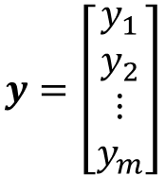
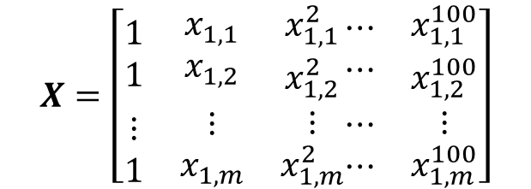
Linear Regression
Polynomial Regression
For n dimensions with 1 instance:
$y=θ_{0}+θ_{1}x_{1}+θ_{2}x_{2}$+…+$θ_{n}x_{n}$
For n dimensions with m instances:
$$y=Xθ$$
$$X=\left[\begin{matrix}\begin{matrix}1 & x_{1,1}^{} \\ 1 & x_{1,2}^{}\end{matrix} & ⋯ & \begin{matrix}x_{n,1}^{} \\ x_{n,2}^{}\end{matrix} \\ ⋮ & ⋯ & ⋮ \\ \begin{matrix}1 & x_{1,m}^{}\end{matrix} & ⋯ & x_{n,m}^{}\end{matrix}\right]$$
$$y=\left[\begin{matrix}\begin{matrix}y_{1} \\ y_{2}\end{matrix} \\ \begin{matrix}⋮ \\ y_{m}\end{matrix}\end{matrix}\right]$$
$$θ=\left[\begin{matrix}\begin{matrix}θ_{0} \\ θ_{1}\end{matrix} \\ \begin{matrix}⋮ \\ θ_{n}\end{matrix}\end{matrix}\right]$$
$$y=θ_{0}+θ_{1}x_{1}+θ_{2}x_{1}^{2}+…+θ_{100}x_{1}^{100}$$
The Normal Equation – a closed-form solution
$$y=\left[\begin{matrix}\begin{matrix}y_{1} \\ y_{2}\end{matrix} \\ \begin{matrix}⋮ \\ y_{m}\end{matrix}\end{matrix}\right]$$
$$X=\left[\begin{matrix}\begin{matrix}1 \\ 1\end{matrix} & \begin{matrix}x_{1,1} \\ x_{1,2}\end{matrix} & \begin{matrix}x_{1,1}^{2} \\ x_{1,2}^{2}\end{matrix} \\ \begin{matrix}⋮ \\ 1\end{matrix} & \begin{matrix}⋮ \\ x_{1,m}\end{matrix} & \begin{matrix}⋮ \\ x_{1,m}^{2}\end{matrix}\end{matrix}\begin{matrix}\begin{matrix}⋯ \\ ⋯\end{matrix} & \begin{matrix}x_{1,1}^{100} \\ x_{1,2}^{100}\end{matrix} \\ \begin{matrix}⋯ \\ ⋯\end{matrix} & \begin{matrix}⋮ \\ x_{1,m}^{100}\end{matrix}\end{matrix}\right]$$
$$θ=\left[\begin{matrix}\begin{matrix}θ_{0} \\ θ_{1}\end{matrix} \\ \begin{matrix}⋮ \\ θ_{100}\end{matrix}\end{matrix}\right]$$
$$\hat{θ}={\left(X^{T}X\right)}^{−1}X^{T}y$$

Slide 15
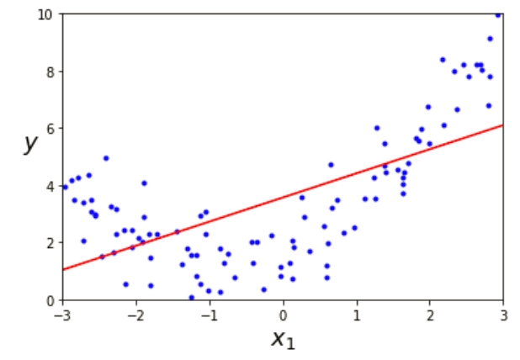


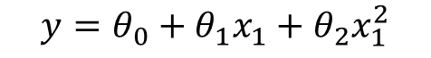
Underfitting & Overfitting
Under-fitting
Appropriate-fitting
Over-fitting
$$y=θ_{0}+θ_{1}x_{1}$$
$$y=θ_{0}+θ_{1}x_{1}+θ_{2}x_{1}^{2}$$
$$y=θ_{0}+θ_{1}x_{1}+θ_{2}x_{1}^{2}+…$$
$$+θ_{100}x_{1}^{100}$$

Slide 16
Logistic Regression
Statistical classification model
Predicts binary response from a binary predictor for predicting the outcome of a categorical dependent variable
Training Data:
Label : 1 0
x₂
x₁

Slide 17
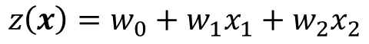
Logistic Regression
Statistical classification model
Predicts binary response from a binary predictor for predicting the outcome of a categorical dependent variable
Training Data:
Label : 1 0
Logit:
$$z\left(x\right)=w_{0}+w_{1}x_{1}+w_{2}x_{2}$$
x₂
x₁

Slide 18
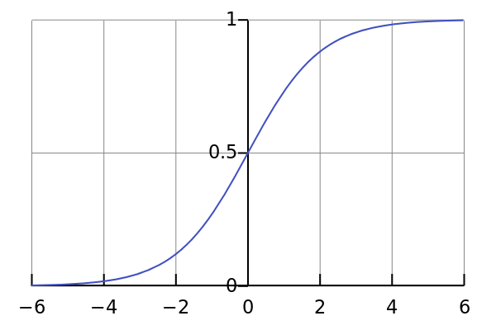
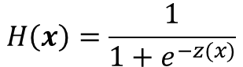
Logistic Regression
Statistical classification model
Predicts binary response from a binary predictor for predicting the outcome of a categorical dependent variable
Training Data:
Label : 1 0
Logit:
$$z\left(x\right)=w_{0}+w_{1}x_{1}+w_{2}x_{2}$$
$$H\left(x\right)=\frac{1}{1+e^{−z(x)}}$$
Hypothesis:
Sigmoid function
x₂
x₁

Slide 19
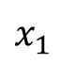
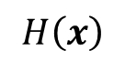
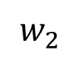
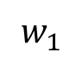
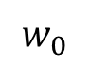
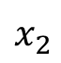
Logistic Regression
Statistical classification model
Predicts binary response from a binary predictor for predicting the outcome of a categorical dependent variable
Training Data:
Label : 1 0
Logit:
$$z\left(x\right)=w_{0}+w_{1}x_{1}+w_{2}x_{2}$$
$$H\left(x\right)=\frac{1}{1+e^{−z(x)}}$$
Hypothesis:
1
$$w_{0}$$
x₂
$$x_{1}$$
$$w_{1}$$
$$H\left(x\right)$$
$$w_{2}$$
$$x_{2}$$
x₁

Slide 20
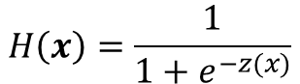
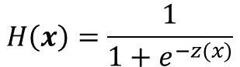
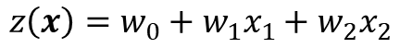
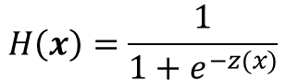
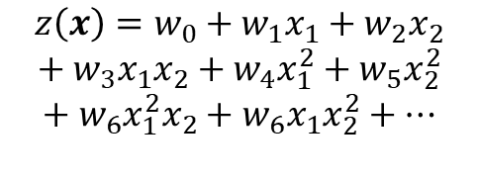
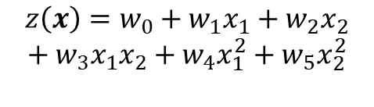
Logistic Regression
Training Data:
x₂
x₂
x₂
x₁
x₁
x₁
Under-fitting
Appropriate-fitting
Over-fitting
$$z\left(x\right)=w_{0}+w_{1}x_{1}+w_{2}x_{2}$$
$$z\left(x\right)=w_{0}+w_{1}x_{1}+w_{2}x_{2}$$
$$+ w_{3}x_{1}x_{2}+w_{4}x_{1}^{2}+w_{5}x_{2}^{2}$$
$$z\left(x\right)=w_{0}+w_{1}x_{1}+w_{2}x_{2}$$
$$+ w_{3}x_{1}x_{2}+w_{4}x_{1}^{2}+w_{5}x_{2}^{2}$$
$$+ w_{6}x_{1}^{2}x_{2}+w_{6}x_{1}x_{2}^{2}+…$$
$$H\left(x\right)=\frac{1}{1+e^{−z(x)}}$$
$$H\left(x\right)=\frac{1}{1+e^{−z(x)}}$$
$$H\left(x\right)=\frac{1}{1+e^{−z(x)}}$$

Slide 21
Logistic Regression
Training Data:
x₂
x₂
x₂
x₁
x₁
x₁
Under-fitting
Appropriate-fitting
Over-fitting
$$z\left(x\right)=w_{0}+w_{1}x_{1}+w_{2}x_{2}$$
$$z\left(x\right)=w_{0}+w_{1}x_{1}+w_{2}x_{2}$$
$$+ w_{3}x_{1}x_{2}+w_{4}x_{1}^{2}+w_{5}x_{2}^{2}$$
$$z\left(x\right)=w_{0}+w_{1}x_{1}+w_{2}x_{2}$$
$$+ w_{3}x_{1}x_{2}+w_{4}x_{1}^{2}+w_{5}x_{2}^{2}$$
$$+ w_{6}x_{1}^{2}x_{2}+w_{6}x_{1}x_{2}^{2}+…$$
$$H\left(x\right)=\frac{1}{1+e^{−z(x)}}$$
$$H\left(x\right)=\frac{1}{1+e^{−z(x)}}$$
How to evaluate model?
Answer: Cross-Validation
$$H\left(x\right)=\frac{1}{1+e^{−z(x)}}$$

Slide 22
Supervised Learning Workflow
Training stage
Training
data
Training
set
Predict
Label
Machine Learning Algorithm
Train
Error
Validation
Error
Validation
Predict
Label
Prediction(test) stage
Test
data
Predict
Machine Learning Algorithm

Slide 23
Cross-Validation
Training stage
Training
data
Training
set
Label
Validation
Label

Slide 24
Cross-Validation
Training stage
Training
data
Training
set
Predict
Label
Machine Learning Algorithm
Train
Error
Validation
Error
Validation
Predict
Label

Slide 25
Cross-Validation
Training stage
Training
data
Training
set
Predict
Label
Machine Learning Algorithm
Train
Error
Validation
Error
Validation
Predict
Label
Optimization
(Minimize Cost Function)

Slide 26
Cross-Validation
Training stage
Training
data
Training
set
Predict
Label
Machine Learning Algorithm
Train
Error
Validation
Error
Validation
Predict
Label
Validation set
Error
Training set
Iteration or model complexity

Slide 27
Underfitting and Overfitting
Training stage
Training
data
Training
set
Predict
Label
Machine Learning Algorithm
Train
Error
Validation
Error
Validation
Predict
Label
Right fit
Underfit
Overfit
Validation set
Error
Training set
Iteration or model complexity

Slide 28
Underfitting and Overfitting
x₂
x₂
x₂
x₁
x₁
x₁
Right fit
Underfit
Overfit
Validation set
Error
Training set
Iteration or model complexity

Slide 29
Regularization
Getting more data
Data augmentation
L1/L2 Regularizations
Bagging (boostrap aggregating)
Pruning
Dropout/DropConnect
Ensemble (stacking)
……
Regularization
Error
Validation set
Training set
Iteration or model complexity

Slide 30
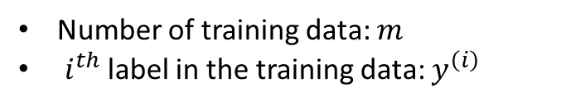
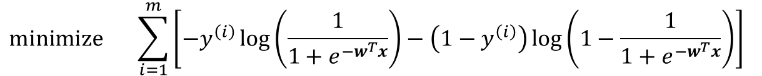

Logistic Regression
Cost function
$$\operatorname{minimize}{ \sum_{i=1}^{m}{\left[−y^{\left(i\right)}\log\left(\frac{1}{1+e^{−w^{T}x}}\right)−\left(1−y^{\left(i\right)}\right)\log\left(1−\frac{1}{1+e^{−w^{T}x}}\right)\right]}}{ }$$
Number of training data: $m$
$i^{th}$ label in the training data: $y^{\left(i\right)}$
Optimization (e.g., gradient decent)
$$w=:w−α∇_{w}C(w)$$

Slide 31



Logistic Regression
Cost function
$$\operatorname{minimize}{ \sum_{i=1}^{m}{\left[−y^{\left(i\right)}\log\left(\frac{1}{1+e^{−w^{T}x}}\right)−\left(1−y^{\left(i\right)}\right)\log\left(1−\frac{1}{1+e^{−w^{T}x}}\right)\right]}}{ }$$
+ Penalty
$$α\sum_{j}^{n}{\left|w_{j}\right|}$$
Number of training data: $m$
$i^{th}$ label in the training data: $y^{\left(i\right)}$
Lasso:
$$\frac{α}{2}\sum_{j}^{n}{w_{j}^{2}}$$
Optimization (e.g., gradient decent)
Ridge:
$$w=:w−α∇_{w}C(w)$$
$$rα\sum_{j}^{n}{\left|w_{j}\right|}+(1−r)\frac{α}{2}\sum_{j}^{n}{w_{j}^{2}}$$
Elastic Net:

Slide 32

Logistic Regression
Cost function
$$\operatorname{minimize}{ \sum_{i=1}^{m}{\left[−y^{\left(i\right)}\log\left(\frac{1}{1+e^{−w^{T}x}}\right)−\left(1−y^{\left(i\right)}\right)\log\left(1−\frac{1}{1+e^{−w^{T}x}}\right)\right]}}{ }$$
+ Penalty
$$α\sum_{j}^{n}{\left|w_{j}\right|}$$
Lasso:
$$\frac{α}{2}\sum_{j}^{n}{w_{j}^{2}}$$
Ridge:
$$rα\sum_{j}^{n}{\left|w_{j}\right|}+(1−r)\frac{α}{2}\sum_{j}^{n}{w_{j}^{2}}$$
Elastic Net:

Slide 33
Logistic Regression
Cost function
$$\operatorname{minimize}{ \sum_{i=1}^{m}{\left[−y^{\left(i\right)}\log\left(\frac{1}{1+e^{−w^{T}x}}\right)−\left(1−y^{\left(i\right)}\right)\log\left(1−\frac{1}{1+e^{−w^{T}x}}\right)\right]}}{ }$$
+ Penalty
$$α\sum_{j}^{n}{\left|w_{j}\right|}$$
Lasso:
$$\frac{α}{2}\sum_{j}^{n}{w_{j}^{2}}$$
Overfitting
Ridge:
$$rα\sum_{j}^{n}{\left|w_{j}\right|}+(1−r)\frac{α}{2}\sum_{j}^{n}{w_{j}^{2}}$$
Underfitting
Elastic Net:

Slide 34
Logistic Regression
Cost function
$$\operatorname{minimize}{ \sum_{i=1}^{m}{\left[−y^{\left(i\right)}\log\left(\frac{1}{1+e^{−w^{T}x}}\right)−\left(1−y^{\left(i\right)}\right)\log\left(1−\frac{1}{1+e^{−w^{T}x}}\right)\right]}}{ }$$
+ Penalty
$$α\sum_{j}^{n}{\left|w_{j}\right|}$$
Lasso:
$$\frac{α}{2}\sum_{j}^{n}{w_{j}^{2}}$$
Overfitting
Ridge:
$$rα\sum_{j}^{n}{\left|w_{j}\right|}+(1−r)\frac{α}{2}\sum_{j}^{n}{w_{j}^{2}}$$
Underfitting
Elastic Net:

Slide 35




Lasso vs. Ridge
$$y=w_{1}x_{1}+w_{2}x_{2}$$
$$α\sum_{j}^{n}{\left|w_{j}\right|}$$
Lasso:
$$y=10$$
$$x_{1}=x_{2}=1$$
$$\frac{α}{2}\sum_{j}^{n}{w_{j}^{2}}$$
Ridge:
$$w_{1}$$ | $$w_{2}$$ | Lasso | Ridge
10 | 0 | 10 + 0 = 10 | 100 + 0 = 100
5 | 5 | 5 + 5 = 10 | 25 + 25 = 50
Lasso results in sparse solutions – vector with more zero coordinates
➔Dimension reduction, save memory

Slide 36

Lasso vs. Ridge
$$α\sum_{j}^{n}{\left|w_{j}\right|}$$
Lasso:
$$\frac{α}{2}\sum_{j}^{n}{w_{j}^{2}}$$
Ridge:
Image taken from [https://onlinecourses.science.psu.edu/stat857/node/158]
Lasso results in sparse solutions – vector with more zero coordinates
➔Dimension reduction, save memory

Slide 37
4. Support Vector Machines

Slide 38
Support Vector Machine (SVM)
SVMs maximize the margin (called ‘street’) around the separating hyperplane.
The decision boundary is fully determined (or “supported”) by the instances located on the edge of the street.
These instances are called support vectors.

Slide 39
Support Vector Machine (SVM)
SVMs maximize the margin (called ‘street’) around the separating hyperplane.
The decision boundary is fully determined (or “supported”) by the instances located on the edge of the street.
These instances are called support vectors.

Slide 40
Support Vector Machine (SVM)
SVMs maximize the margin (called ‘street’) around the separating hyperplane.
The decision boundary is fully determined (or “supported”) by the instances located on the edge of the street.
These instances are called support vectors.

Slide 41
Support Vector Machine (SVM)
SVMs maximize the margin (called ‘street’) around the separating hyperplane.
The decision boundary is fully determined (or “supported”) by the instances located on the edge of the street.
These instances are called support vectors.
Maximize
Margin

Slide 42
Support Vector Machine (SVM)
SVMs maximize the margin (called ‘street’) around the separating hyperplane.
The decision boundary is fully determined (or “supported”) by the instances located on the edge of the street.
These instances are called support vectors.
Support Vectors
Maximize
Margin

Slide 43
Support Vector Machine (SVM)
SVMs maximize the margin (called ‘street’) around the separating hyperplane.
The decision boundary is fully determined (or “supported”) by the instances located on the edge of the street.
These instances are called support vectors.
Maximize
Margin

Slide 44


Maximizing the margin (aka street width)
$$H_{0}: w∙x+b=0$$
$$H_{1}: w∙x+b=1$$
So, the distance between $H_{0}$ and $H_{1}$ is then:
$$d^{+}=\frac{1}{\left\|w\right\|}$$
The total distance between $H_{1}$ and $H_{2}$ is $\frac{2}{\left\|w\right\|}$
We want a classifier (decision boundary) maximizing the distance (margin):

Slide 45



Maximizing the margin (aka street width)
We want a classifier (decision boundary) maximizing the distance (margin):
$maximize \frac{2}{\left\|w\right\|}$ or $minimize\left\|w\right\|$
For a simple derivative, the hard margin linear SVM classifier objective is
$$minimize \frac{1}{2}{\left\|w\right\|}^{2}=\frac{1}{2}w^{T}∙w$$
$$subject to t^{\left(i\right)}\left(w^{T}∙x^{\left(i\right)}+b\right)≥1$$
$for i=1, 2, …, m$
➔ Quadratic Programming Problem
$t^{\left(i\right)}$=1
$t^{\left(i\right)}$=-1

Slide 46
Margin Violations

Slide 47
Margin Violations
Outlier

Slide 48
Margin Violations
??
Outlier

Slide 49





Maximizing the margin (aka street width)
Soft margin linear SVM classifier objective:
$$minimize \frac{1}{2}w^{T}∙w+C\sum_{i=1}^{m}{η^{(i)}}$$
$subject to t^{\left(i\right)}\left(w^{T}∙x^{\left(i\right)}+b\right)≥1−η^{(i)}$ and $η^{(i)}≥0$
$for i=1, 2, …, m$
➔ Quadratic Programming Problem
$$H_{0}$$
$$w∙x+b=1$$
$$w∙x+b=0$$
$$w∙x+b=−1$$

Slide 50
Maximizing the margin (aka street width)
Soft margin linear SVM classifier objective:
$$minimize \frac{1}{2}w^{T}∙w+C\sum_{i=1}^{m}{η^{(i)}}$$
$subject to t^{\left(i\right)}\left(w^{T}∙x^{\left(i\right)}+b\right)≥1−η^{(i)}$ and $η^{(i)}≥0$
$for i=1, 2, …, m$
➔ Quadratic Programming Problem
$$H_{0}$$
$$w∙x+b=1$$
$$w∙x+b=0$$

Slide 51

Maximizing the margin (aka street width)
Soft margin linear SVM classifier objective:
$$minimize \frac{1}{2}w^{T}∙w+C\sum_{i=1}^{m}{η^{(i)}}$$
$subject to t^{\left(i\right)}\left(w^{T}∙x^{\left(i\right)}+b\right)≥1−η^{(i)}$ and $η^{(i)}≥0$
$for i=1, 2, …, m$
➔ Quadratic Programming Problem
$$H_{0}$$
$$w∙x+b=1$$
$$w∙x+b=1−η$$
$$w∙x+b=0$$

Slide 52

Maximizing the margin (aka street width)
Soft margin linear SVM classifier objective:
$$minimize \frac{1}{2}w^{T}∙w+C\sum_{i=1}^{m}{η^{(i)}}$$
$subject to t^{\left(i\right)}\left(w^{T}∙x^{\left(i\right)}+b\right)≥1−η^{(i)}$ and $η^{(i)}≥0$
$for i=1, 2, …, m$
➔ Quadratic Programming Problem
$$H_{0}$$
$$w∙x+b=1$$
$$w∙x+b=0$$
$$w∙x+b=1−η$$

Slide 53


Maximizing the margin (aka street width)
Soft margin linear SVM classifier objective:
$$minimize \frac{1}{2}w^{T}∙w+C\sum_{i=1}^{m}{η^{(i)}}$$
$subject to t^{\left(i\right)}\left(w^{T}∙x^{\left(i\right)}+b\right)≥1−η^{(i)}$ and $η^{(i)}≥0$
$for i=1, 2, …, m$
➔ Quadratic Programming Problem

Slide 54

Nonlinear SVM Classification
Adding Polynomial features

Slide 55

Nonlinear SVM Classification
Adding Polynomial features
Adding $x_{2}={\left(x_{1}\right)}^{2}$

Slide 56
Nonlinear SVM Classification
Adding Polynomial features
Adding $x_{2}={\left(x_{1}\right)}^{2}$
At a low polynomial degree it cannot deal with very complex datasets, and
with a high polynomial degree it creates a huge number of features, making the model too slow ➔ Kernel Trick!!

Slide 57

Nonlinear SVM Classification
Landmark
Adding Similarity Features
Gaussian Radial Basis Function (RBF)

Slide 58
Nonlinear SVM Classification
Landmark
Adding Similarity Features
Gaussian Radial Basis Function (RBF)
Creating a landmark at the location of each and every instance in the dataset increase many dimensions and thus creates a huge number of features ➔ Kernel Trick!!

Slide 59



Kernel Trick
2nd-degree polynomial kernel:
Kernel trick for a 2nd-degree polynomial mapping:

Slide 60


Kernel Trick
Making predictions with a kernelized SVM:

Slide 61








SVM Regression
instead of trying to fit the largest possible street between two classes while limiting margin violations, SVM Regression tries to fit as many instances as possible on the street while limiting margin violations
Classification
Regression
$$H_{0}$$
$$H_{0}$$
$$w∙x+b=1$$
$$w∙x+b=ε$$
$$w∙x+b=0$$
$$w∙x+b=0$$
$$w∙x+b=−1$$
$$w∙x+b=−ε$$

Slide 62

SVM Regression
instead of trying to fit the largest possible street between two classes while limiting margin violations, SVM Regression tries to fit as many instances as possible on the street while limiting margin violations

Slide 63
5. Model Evaluation

Slide 64


Regression vs. Classification

Slide 65



Performance Measure
Regression:
Mean Absolute Error:
Root Mean Square Error:
…
Confusion Matrix
Classification:
Accuracy
Precision
Recall
F1 Score

Slide 66
Confusion Matrix
질문) 그림의 숫자가 5 입니까?

Slide 67
Confusion Matrix
질문) 그림의 숫자가 5 입니까?
True Negative:
아니요(Negative) ➔ 딩동댕!(True)
False Positive:
네 (Positive) ➔ 땡!(False)
False Negative:
아니요(Negative) ➔ 땡! (False)
True Positive:
네 (Positive) ➔ 딩동댕! (True)

Slide 68
Confusion Matrix
True Negative:
아니요(Negative) ➔ 딩동댕!(True)
False Positive:
네 (Positive) ➔ 땡!(False)
False Negative:
아니요(Negative) ➔ 땡! (False)
True Positive:
네 (Positive) ➔ 딩동댕! (True)
Accuracy: 예측이 얼마나 정확한가?
(TP + TN)/total
Precision: “네”라고 했을 때, 예측이 얼마나 정확한가?
TP/(TP + FP)
Recall: 실제 그림이 5일때, 예측이 얼마나 정확한가?
TP/(TP + FN)
F1 Score: recall과 precision의 조화평균
2*(Recall*Precision)/(Recall + Precision)

Slide 69
Confusion Matrix Example
환자 100명 중 암환자 4 명
Total = 100 | Predicted: NO | Predicted: YES
Actual: NO | TN 96 | FP 0
Actual: YES | FN 4 | TP 0
Total = 100 | Predicted: NO | Predicted: YES
Actual: NO | TN 91 | FP 5
Actual: YES | FN 0 | TP 4
Total = 100 | Predicted: NO | Predicted: YES
Actual: NO | TN 93 | FP 3
Actual: YES | FN 1 | TP 3
Accuracy | 96%
Precision | 0%
Recall | 0%
F1 score | 0%
Accuracy | 95%
Precision | 44%
Recall | 100%
F1 score | 62%
Accuracy | 96%
Precision | 50%
Recall | 75%
F1 score | 60%

Slide 70
Precision vs. Recall
아이들을 위한 동영상 추천
Total = 100 | Predicted: NO | Predicted: YES
Actual: NO | TN 93 | FP 3
Actual: YES | FN 0 | TP 4
Total = 100 | Predicted: NO | Predicted: YES
Actual: NO | TN 96 | FP 0
Actual: YES | FN 3 | TP 1
Not Safe
Not Safe
Safe
Safe
Accuracy | 97%
Precision | 57%
Recall | 100%
Accuracy | 97%
Precision | 100%
Recall | 25%

Slide 71
Precision vs. Recall
감시카메라에서의 예상 범죄자 사진 보여주는 모델
Total = 100 | Predicted: NO | Predicted: YES
Actual: NO | TN 93 | FP 3
Actual: YES | FN 0 | TP 4
Total = 100 | Predicted: NO | Predicted: YES
Actual: NO | TN 96 | FP 0
Actual: YES | FN 3 | TP 1
범죄자 아님
범죄자 아님
범죄자
범죄자
Accuracy | 97%
Precision | 57%
Recall | 100%
Accuracy | 97%
Precision | 100%
Recall | 25%

Slide 72


Precision/Recall Tradeoff

Slide 73

Precision vs. Recall

Slide 74

The ROC Curve
Random classifier
Area Under the Curve (AUC)
True Positive Rate(TPR) : recall
False Positive Rate(FPR) = FP/(FP + TN)

Slide 75
Single Validation
Training
data
Training
set
Predict
Label
Machine Learning Algorithm
Train
Error
Validation
Error
Validation
Predict
Label

Slide 76
k-fold Cross Validation
k-fold Cross Validation
k = 5
Training
data
Training
set
Training
set
Training
set
Validation
Validation
Training
set
Validation
Training
set
Validation
Validation

Slide 77
k-fold Cross Validation
k-fold Cross Validation
k = 5
Training
data
Training
set
Machine Learning Algorithm
Validation
Prediction
Score

Slide 78
k-fold Cross Validation
k-fold Cross Validation
k = 5
Training
data
Training
set
Training
set
Training
set
Validation
Prediction
Score
Validation
Training
set
Prediction
Score
Validation
Training
set
Prediction
Score
Validation
Prediction
Score
Validation
Prediction
Score
Estimate Model

